Slide 1
Bayesian Belief Network

Slide 2
Full Joint Distribution Issues
full joint probability distribution - can answer any question about the domain.
Intractably large as the number of variables grows.
specifying probabilities - possible worlds - unnatural and tedious.
independence and conditional independence relationships among variables - reduce the number of probabilities that need to be specified.

Slide 3
Bayesian network
Bayesian networks can represent essentially any full joint probability distribution and in many cases can do so very concisely.
A Bayesian network is a directed graph:
Each node - random variable - discrete or continuous.
An arrow from node X to node Y , X is said to be a parent of Y. – DAG
node Xi has P(Xi | Parents(Xi)) - quantifies the effect of the parents on the node.

Slide 4
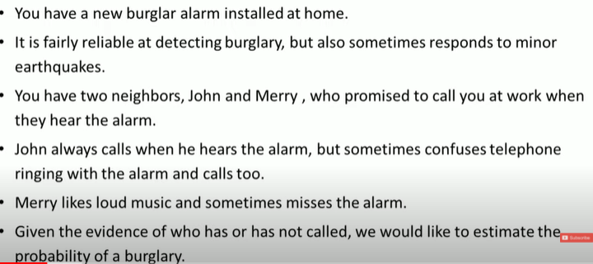
Bayesian Belief Network

Slide 5
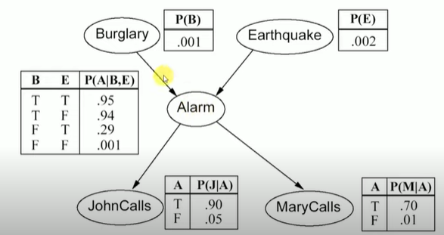
Bayesian Belief Network

Slide 6

Bayesian Belief Network

Slide 7
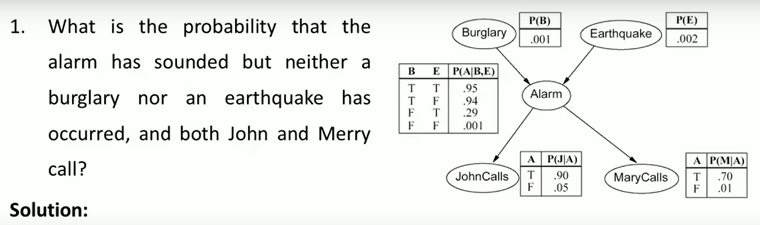
Bayesian Belief Network

Slide 8
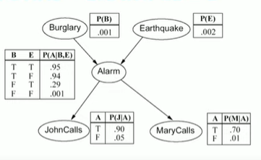
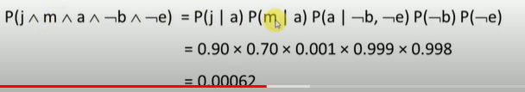
Bayesian Belief Network

Slide 9
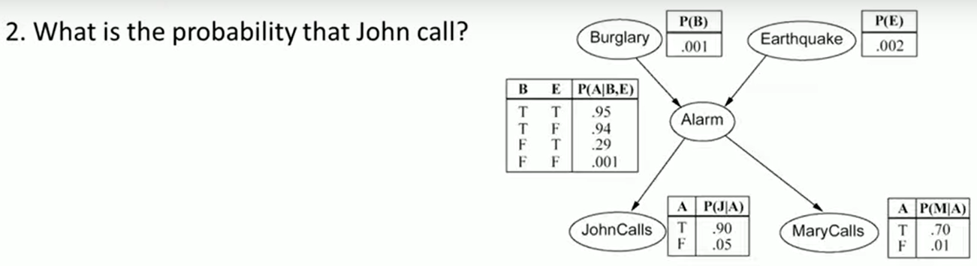
Bayesian Belief Network

Slide 10
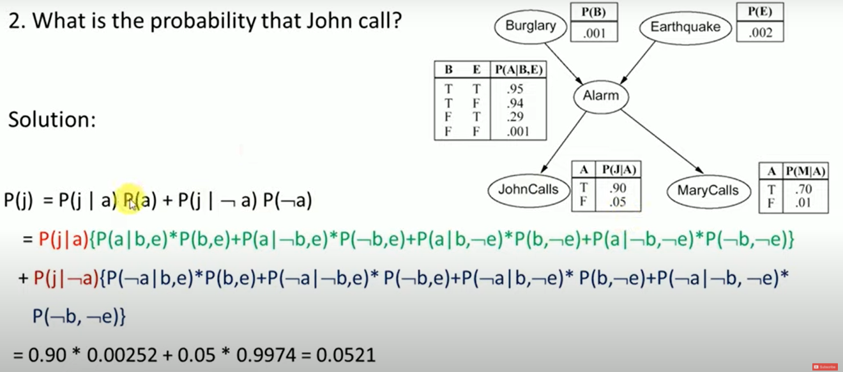
Bayesian Belief Network

